Slide 1

Physics in the Home

Slide 2
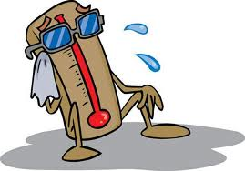
Temperature (T)
measure of hotness or coldness
Units:
Celsius (°C)
Fahrenheit (°F)
Kelvin (K)

Slide 3
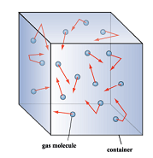
Temperature (T)
Associated with the motion of molecules, atoms, particles that make up the system
Measure of random average translational kinectic energy of molecules of the body

Slide 4
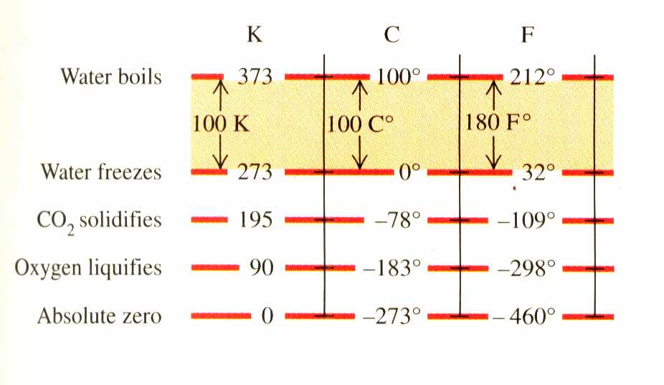
TEMPERATURE SCALES

Slide 5
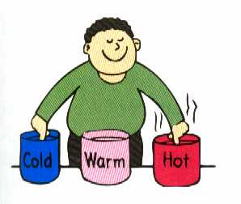
Relationship between scales
Fahrenheit (T_{F}) and Celsius (T_{C}):
T_{F} = 9/5 T_{C} + 32°
T_{C} = 5/9 (T_{F}-32°)
Kelvin (T_{K}) and Celsius:
T_{K} = T_{C} + 273.15

Slide 6
HEAT (Q)
Amount of energy transferred from one system to another because of a difference in temperature.
Energy in transit
Scalar quantity
Unit: Joule (J) [SI], calorie (cal)
1 cal = 4.186 J

Slide 7
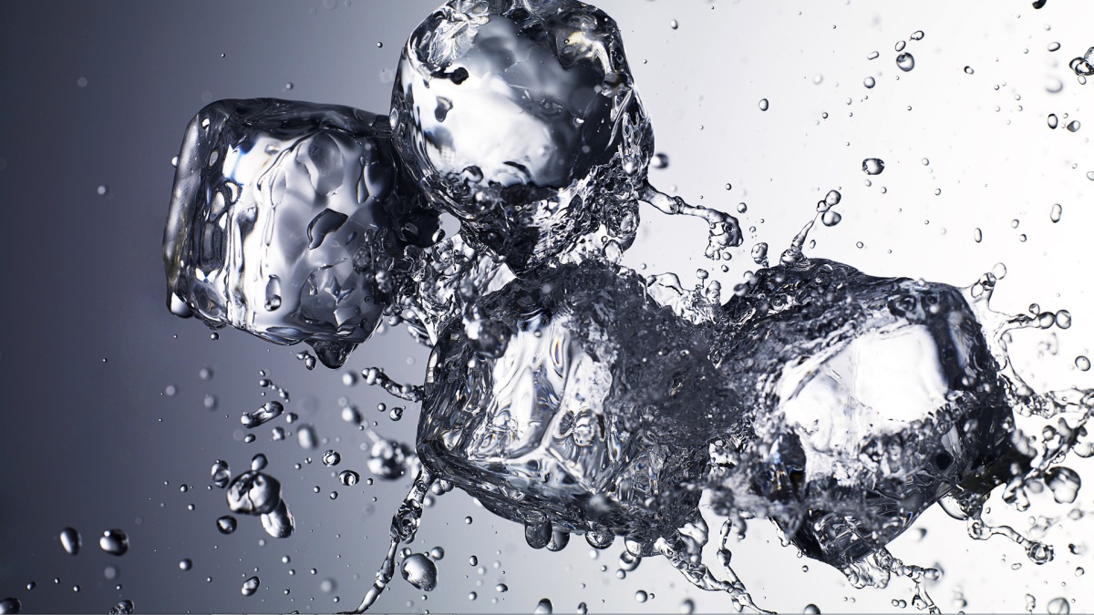
Effects of Heat
Change in dimensions (e.g., volume)
Change in temperature
Change in phase

Slide 8
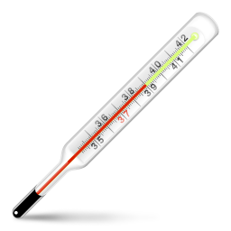
Change in dimension
www.iconarchive.com

Slide 9
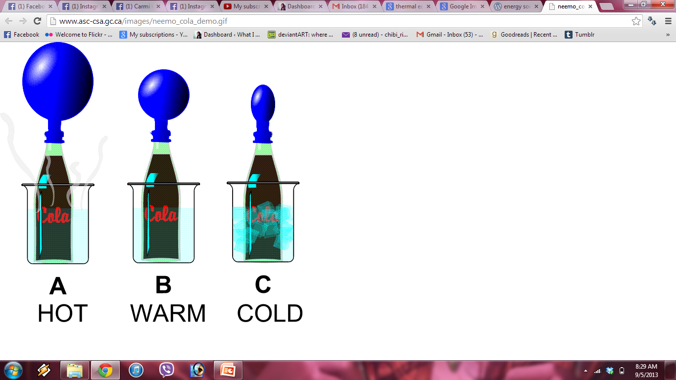
Expansion
http://benabb.wordpress.com/2010/05/28/energy-source/

Slide 10
Change in Temperature
Q = heat
m = mass
c = specific heat
ΔT = temperature

Slide 11
Change in Temperature
Specific heat (c) - Amount of heat required to cause a unit mass of a substance to change its temperature by 1ºC
Higher specific heat means more difficult to change temperature

Slide 12
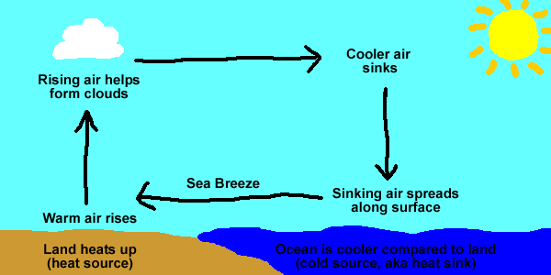
Day: Sea Breeze
Land has lower specific heat (c) than water
Day: land → easier to warm than water

Slide 13
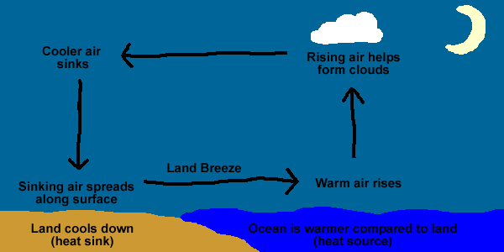
Night: Land Breeze
Land has lower specific heat (c) than water
Night: land → easier to cool than water

Slide 14
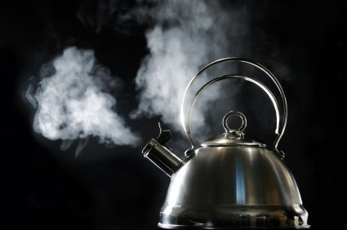
Change in Phase
Q = heat
m = mass
L = latent heat capacity
news.softpedia.com -

Slide 15
Mechanism of Heat Transfer
Conduction- transfer of energy by direct contact
Convection- transfer of energy due to movement of mass
Radiation- transfer of energy by means of electromagnetic radiation (EM)

Slide 16
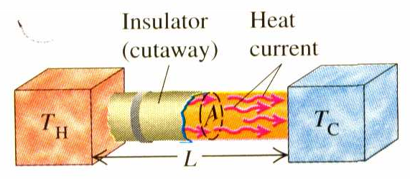
CONDUCTION
transfer of energy by direct contact
occurs through molecular collisions
Direction: high T → low T

Slide 17
CONDUCTION
rate of conduction (H) depends on:
k – thermal conductivity of a material
A = area
L = length
T_{H}= higher temperature
T_{C} = lower temperature

Slide 18
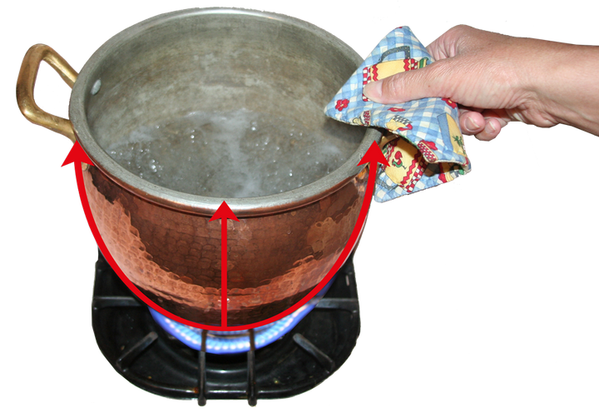
CONDUCTION
slow rate of heat transfer → low thermal conductivity or thermal insulators
www.enerchek-insulation.com

Slide 19
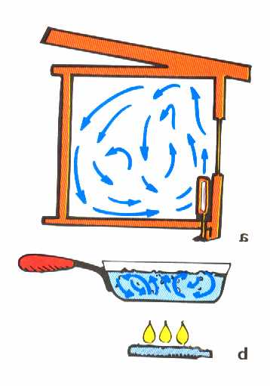
CONVECTION
heat transfer by the actual motion of the fluid
Convection currents in air and liquid

Slide 20
CONVECTION
natural convection: HOT fluids displace COLD fluids
Forced convection: regulate transfer of mass (e.g., use of air blower)

Slide 21

RADIATION
transfer of energy by means of electromagnetic (EM) radiation
Can occur in vacuum or empty space --- no need for material medium

Slide 22
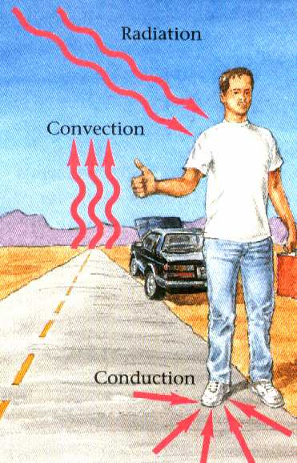

Slide 23
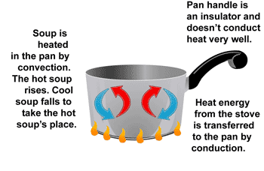
Conduction and Convection
wikispaces

Slide 24
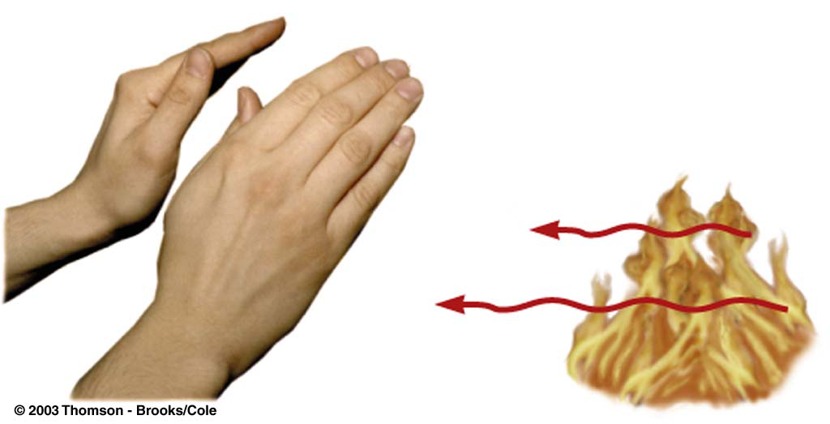
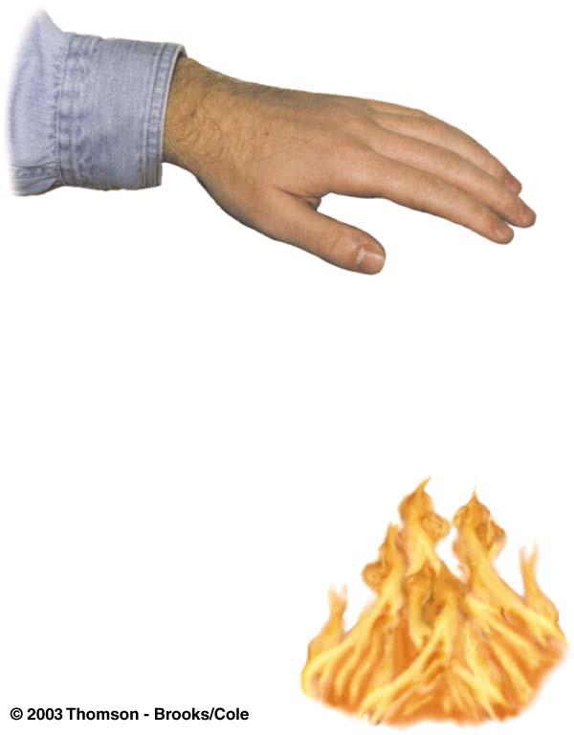
Convection and Radiation
Hot air rises
No physical contact is necessary
wikispaces

